Slide 1
6D CMP Helix

Slide 2
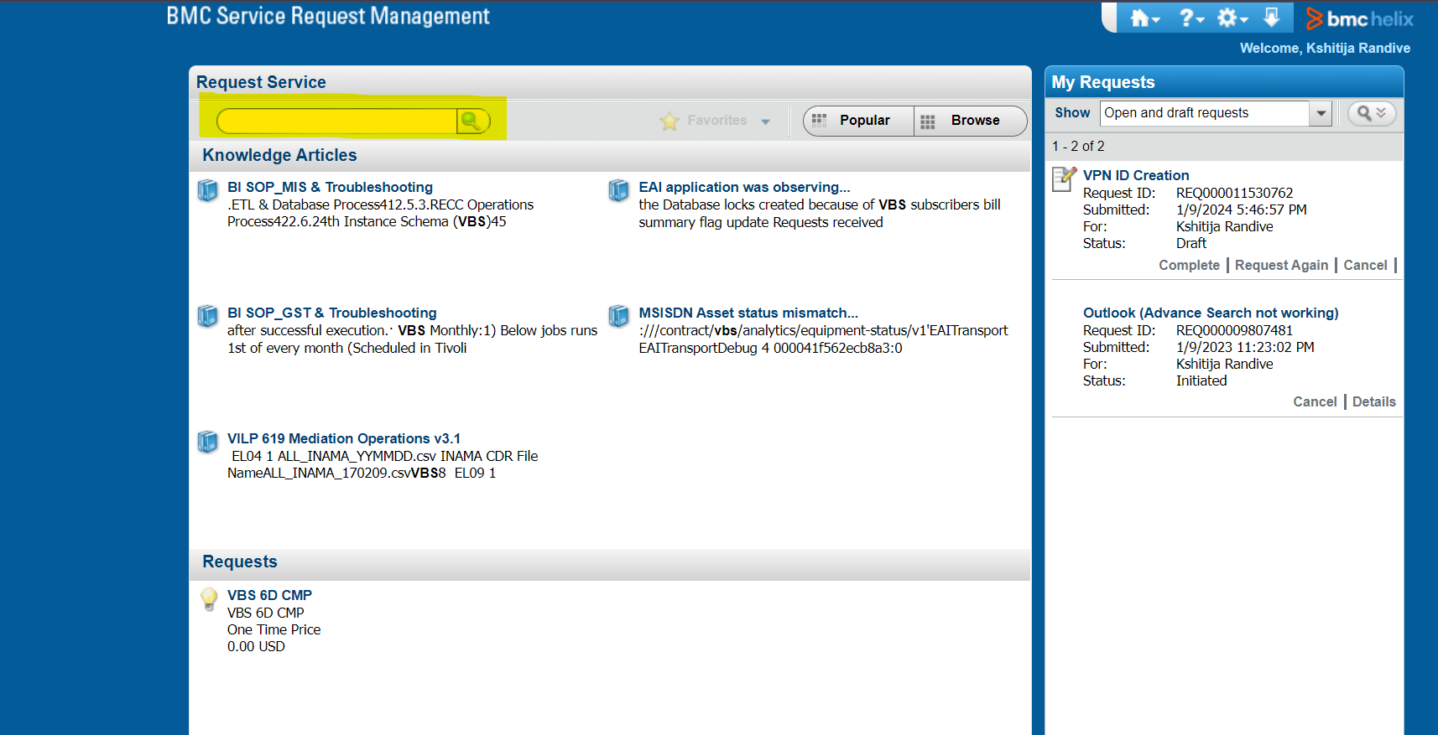

Slide 3
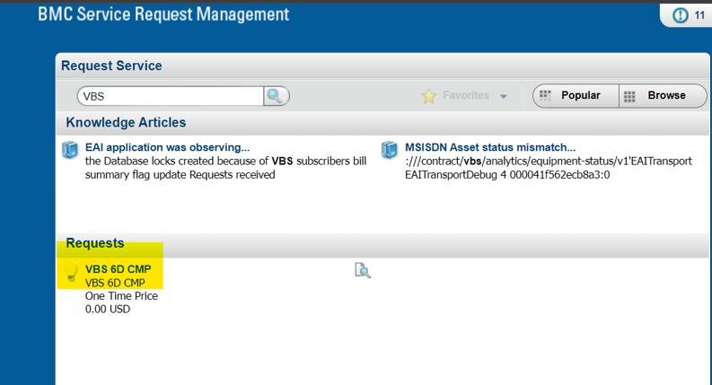

Slide 4
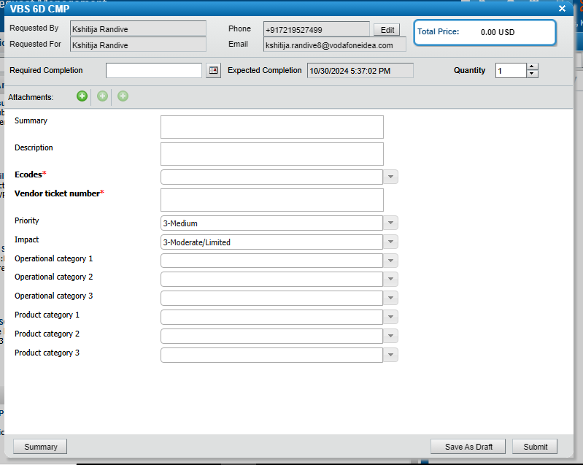

Slide 5
For Sending mail format will be same which we are following only in TO- don’t mention IT ID mail ID
Summary- Subject Link of the Mail
Description- The mail body
Ecode- Reported enterprise e-code.
Vendor Ticket number- HPSM ticket ID
Priority: Category are provided in the next slide
Impact: Category are provided in the next slide
Operational Category 1- Application
Operational Category 2- Application
Operational Category 3- VBS
Product Category 1- 6D CMP

Slide 6
IOT Service Impacted Category
Category | Service Impacting | S3/S4
APN Service impact | Yes | S3
Billing Count mismatch | No | S4
Billing Service Impacting | Yes | S3
Camel flag mismatch | Yes | S3
Customer Query | No | S4
Customer Requirement | No | S4
Duplicate | No | S4
GPRS Service barred | Yes | S3
HLR View mismatch | Yes | S3
Migration Data Mismatch | Yes | S3
No action required | No | S4
Order Delay | Yes | S3
Order failed | Yes | S3
Report | No | S4
SMS barring | Yes | S3
Service Request | No | S4
User Understanding Issue | No | S4
Data/SMS Not working | Yes | S3
Wrongly assigned | No | S4
Number Whitelisting | Yes | S3

Slide 7
Product Category 2 and Product Category 3 -below refer below table:
Category | Subcategory
CMP portal related | Portal not working
 | Profile/Features not visible
 | Portal Features not working
 | Other CMP portal related
Activation/Deactivation | Suspension/Reactivation
 | Delay in provisioning order
Enquiry | Billing And Payment
 | CMP
 | Other
Whitelisting issue | SMS whitelisting
 | Voice whitelisting
 | Data whitelisting

Slide 8
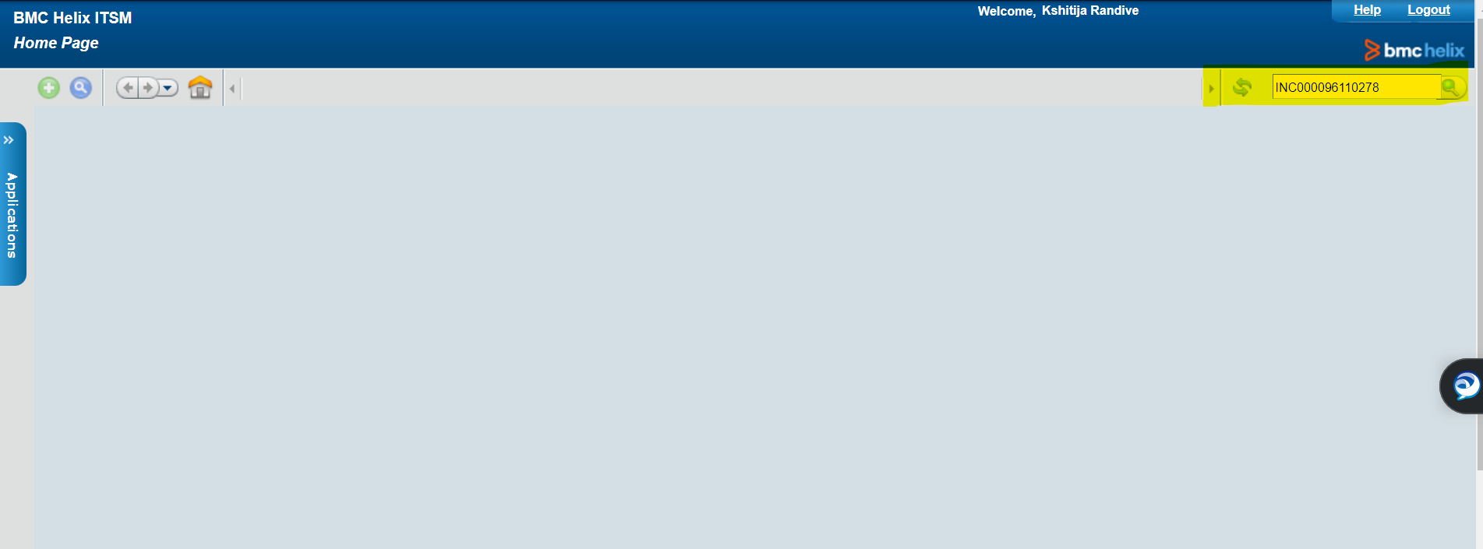

Slide 9
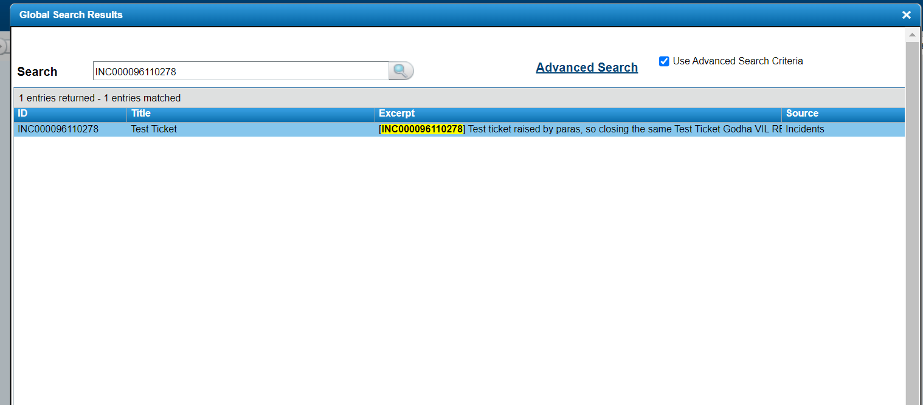

Slide 10
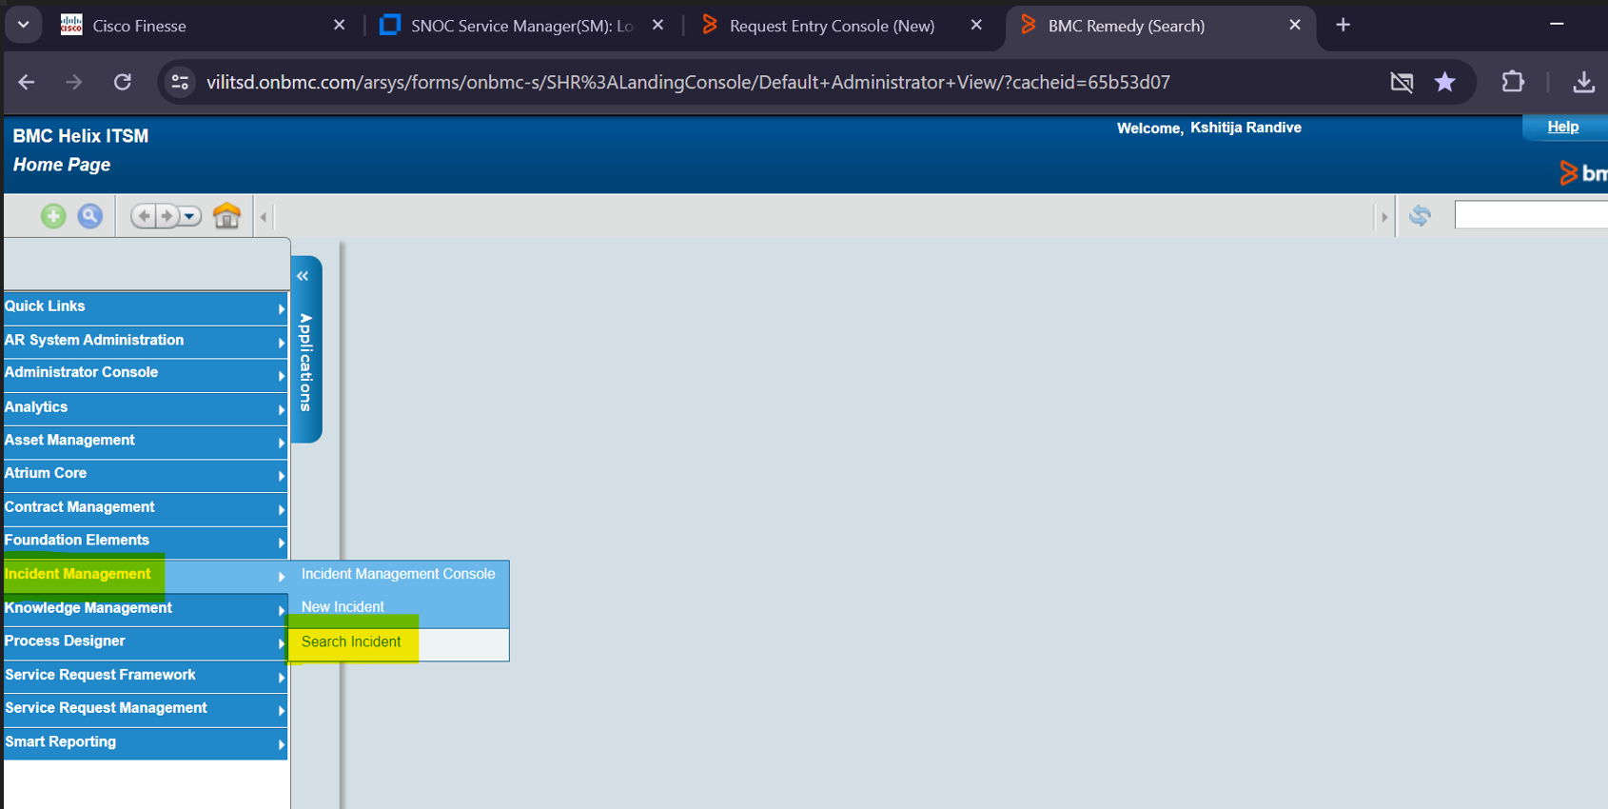

Slide 11
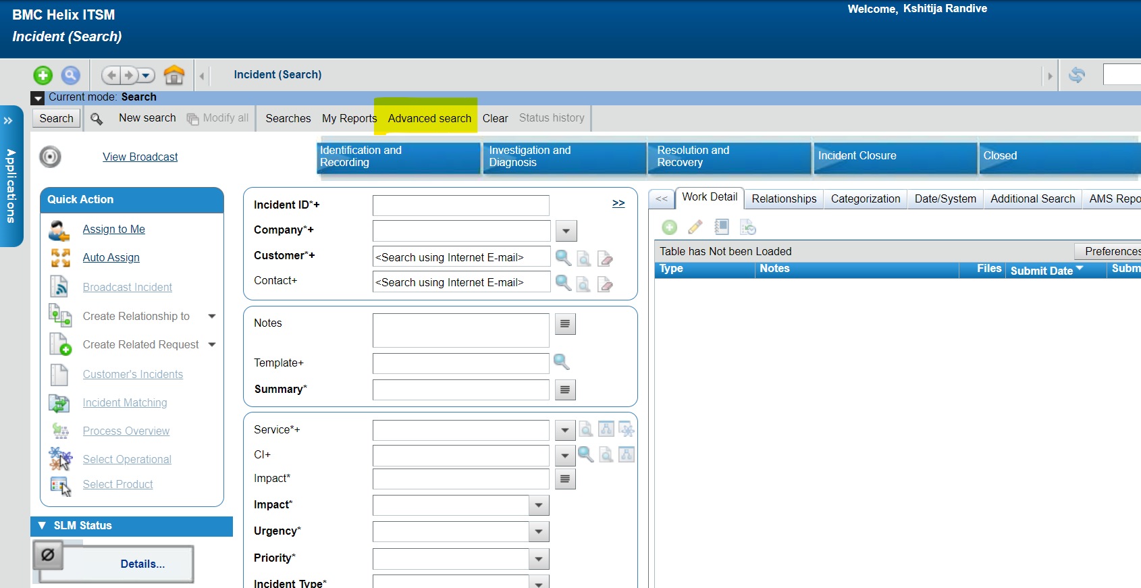

Slide 12
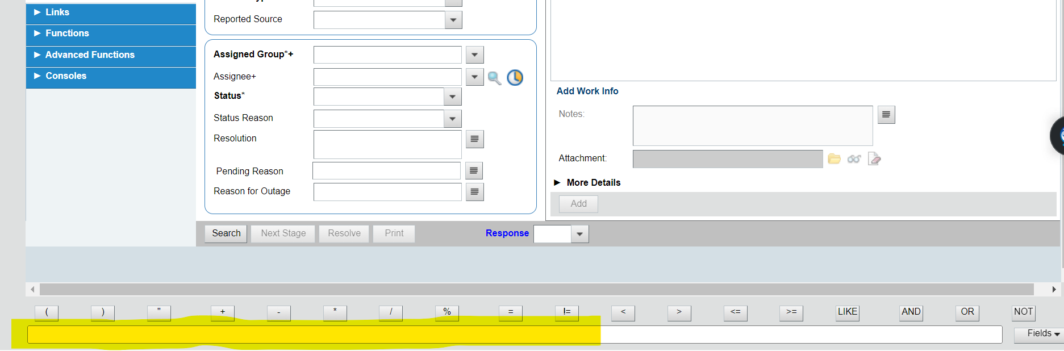

Slide 13
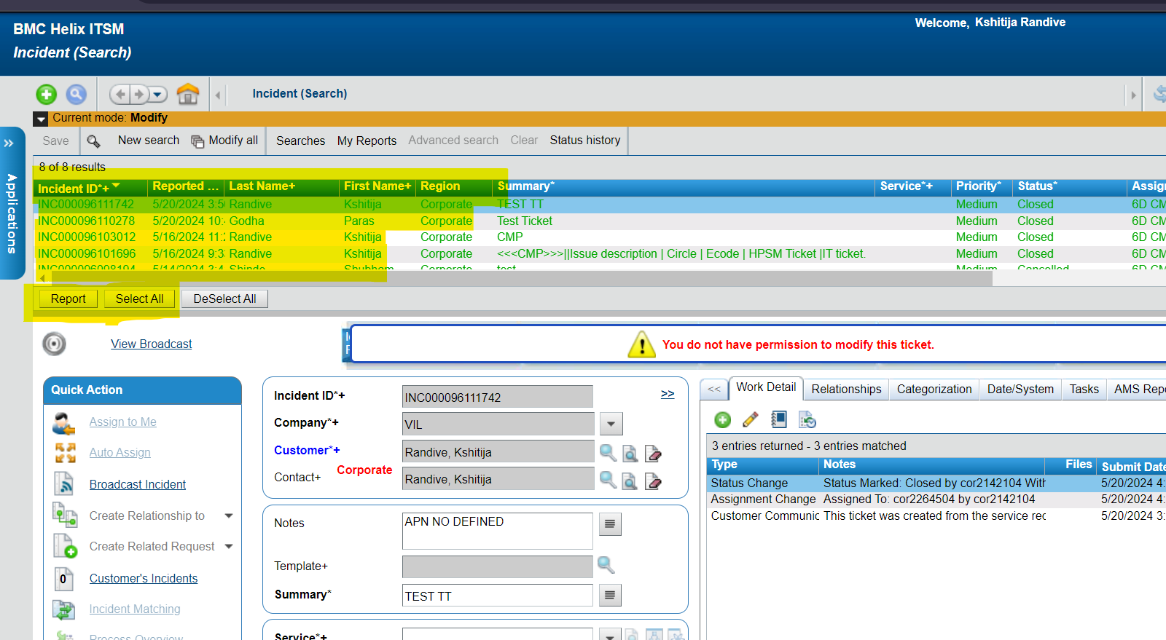

Slide 14
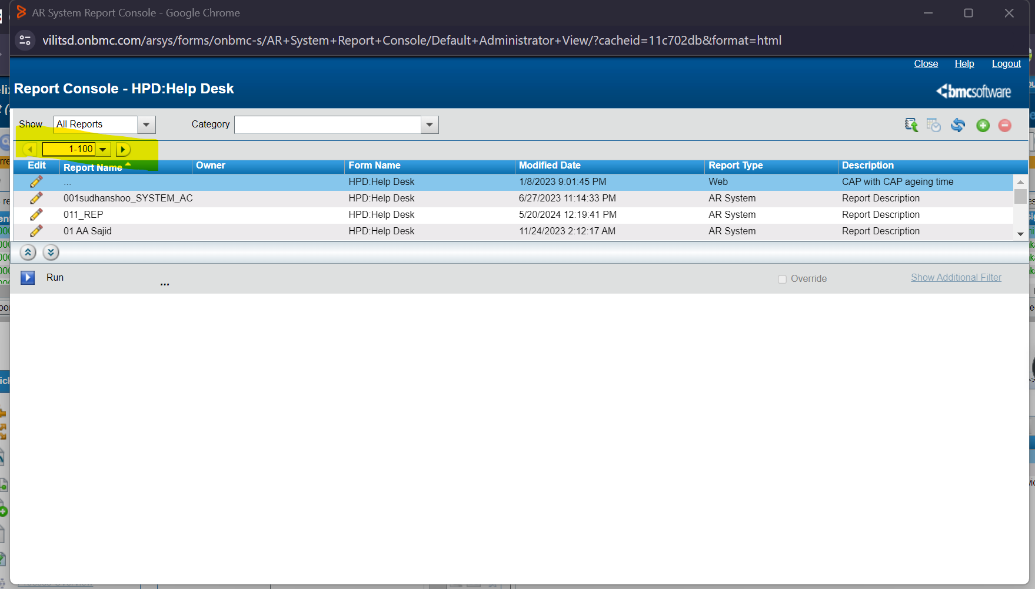

Slide 15
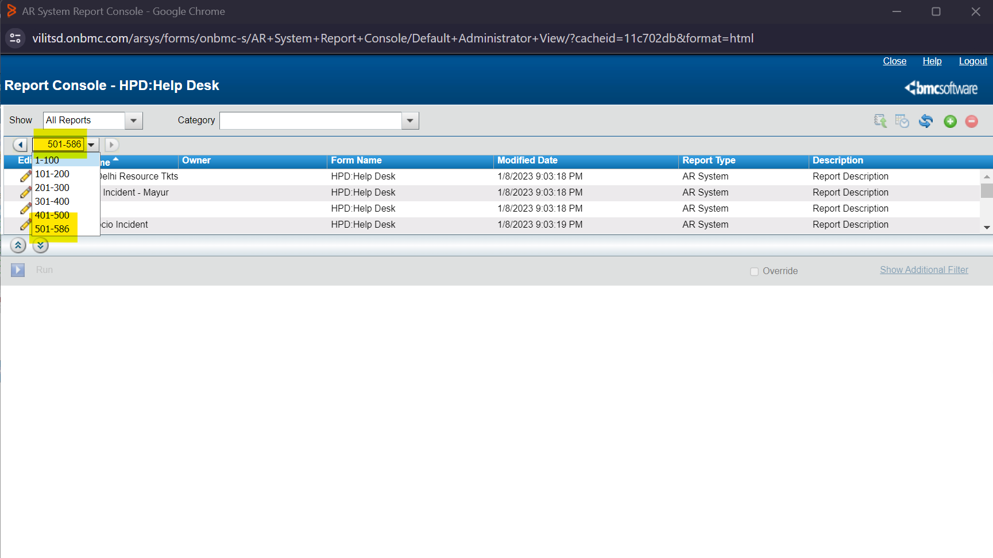

Slide 16
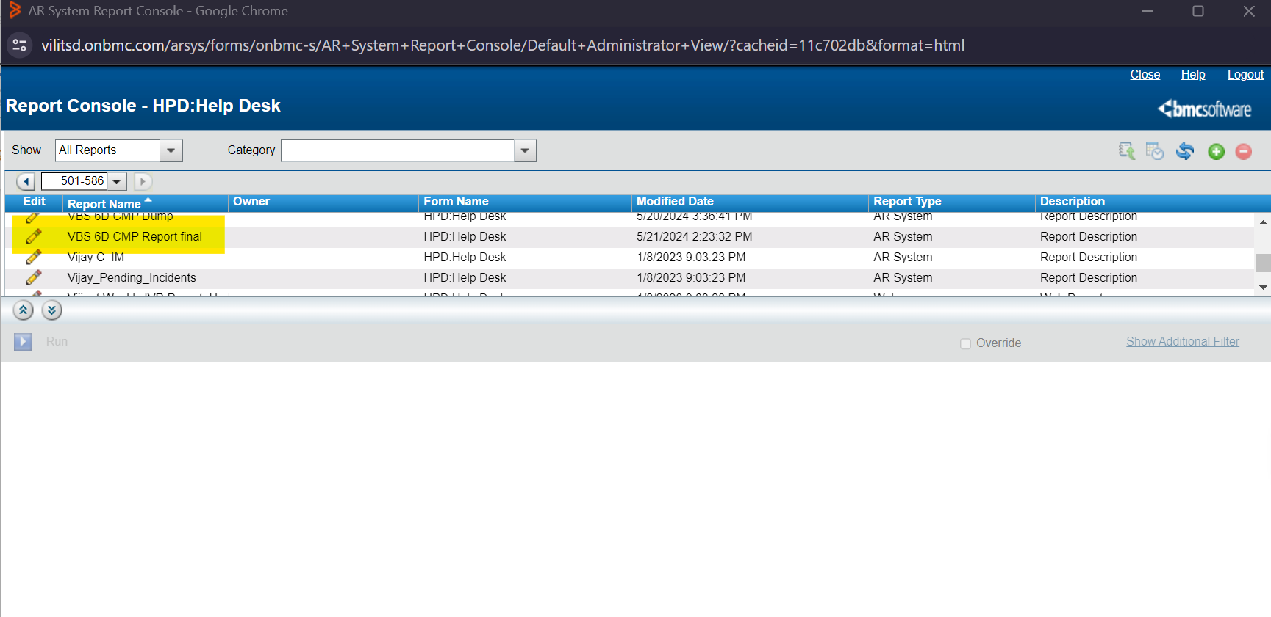

Slide 17
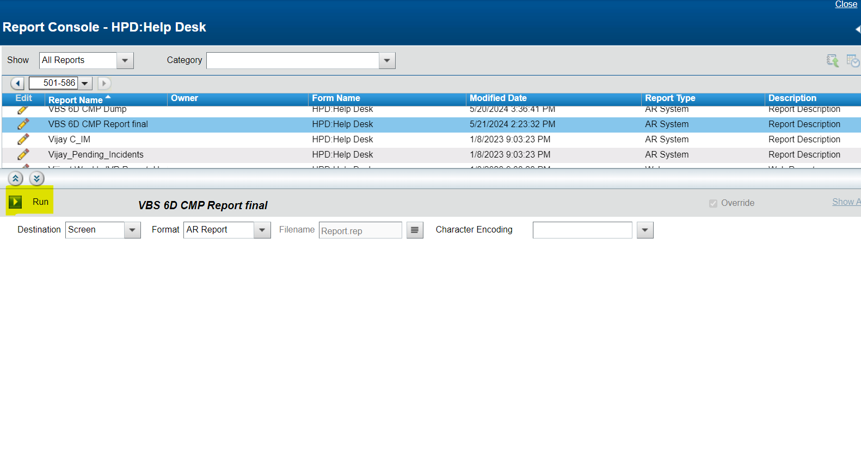

Slide 18
